Slide 1
Digital Logic Design
Lecture 1A
Imran Siddiqi
imran.siddiqi@mcs.edu.pk
Computer Science Department
College of Telecommunication Engineering
National University of Sciences and Technology

Slide 2
Course Information
Lectures
  Monday – 2 lectures
  Wednesday – 1 lecture
Resources
  Web: http://learn.mcs.edu.pk
  Lecture slides, quizzes and assignments + solutions

Slide 3
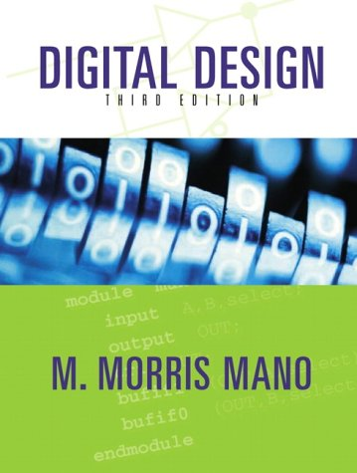
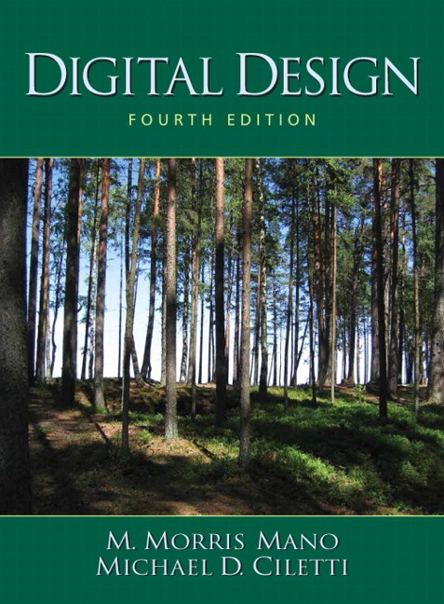
Course Information
Books
  Digital Design, by Mano and Ciletti, Fourth Edition, Prentice Hall

Slide 4
Course Information
Reference
  Logic and Computer Design Fundamentals, 4th ed. by Mano and Kime, Prentice Hall
  Computer Aided Logic Design, by Hill and Peterson, John Wiley
  Contemporary Logic Design, by Randy Katz, Benjamin Cummings
  Digital Circuits, by Newicki and Adam, Edward Arnold Publishing
  Fundamentals of Logic Design,Charles Roth Jr

Slide 5


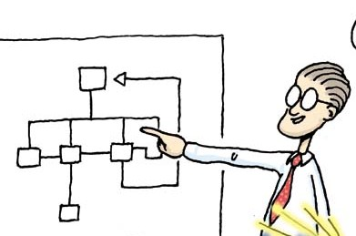

Course Information
Class Composition
Readings
Lectures
Assignments
Quizzes

Slide 6



Course Information
Assignments
On Time
Late Sub: -25%
No Copying

Slide 7
Course Outline
Binary Systems
Binary Algebra
Simplification of Boolean Functions
Combinational Logic
Sequential Logic
Sequential Circuits

Slide 8
Chapter 1 – Digital Systems and Binary Numbers

Slide 9
Contents
Analog versus Digital Systems
Digitization of Analog Signals
Binary Numbers and Number Systems
Number System Conversions
Representing Fractions

Slide 10




Digital Systems
Digital Systems exist everywhere
  Communication, banks, hospitals, Internet etc.
Computers are digital systems

Slide 11
Analog vs Digital Systems
Analog means continuous
Analog parameters have continuous range of values
  Example: temperature is an analog parameter
  Temperature increases/decreases continuously
Kettle removed from stove
100ºC
temperature
time

Slide 12
Analog vs Digital Systems
Digital signals are non-continuous i.e. discrete
  Consist of fixed set of digits. E.g. number of months in a year = 12; digits = {1,2,3,….,10,11,12} note that 11.3 or 4.9 are invalid here
  Abrupt transition (jumping) from one digit to another
11
12
9
10
7
8
5
6
3
4
1
2
Value
Jan Feb Mar Apr May Jun Jul Aug Sep Oct Nov Dec

Slide 13

Analog vs Digital Systems
Q: Digital or Analog?
  English letters
  Internet IP addresses
  Human voice
  Week days

Slide 14
Analog vs Digital Systems
Analog
Digital

Slide 15
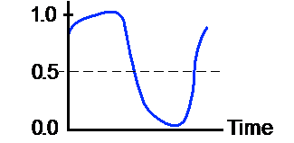
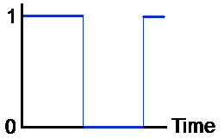
Digitization
Process of conversion from analog to digital is called digitization

Slide 16
Computers
Computers are digital systems
Deal with a vocabulary of two elements namely 0 and 1 – also known as the binary system of numbers
Binary digits i.e. 0 and 1 are called bits
1
1
0

Slide 17
bit
binary digit

Slide 18
Next…
Analog versus Digital Systems
Digitization of Analog Signals
Binary Numbers and Number Systems
Number System Conversions
Representing Fractions

Slide 19



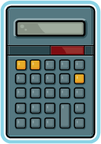


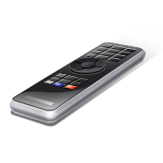
Binary Number System
63
16
23
16
63
Decimal-to-Binary
Conversion
721
935
23
534
935
721
534
234
275
935
935
275
145
137
137
234
145
010
10101
00100
1101
10010
010
1101
00101101
0101011
1101
010
10010
1101
00100
010
00101101
00101
Binary-to-Decimal
Conversion
1101
011011
00100
011011
011011
00101101
0101011
0101011
1101
10010
10010
10101
011011
001011
00101101
00100
Notes:
Introductory Slide / Overview of Presentation
Explain that humans use base ten (or decimal), because we have ten fingers and that digital electronics uses base-two (binary) because it only understands two states; ON and OFF. For students to be able to analyze and design digital electronics, they need to be proficient at converting numbers between these two number systems.
Base ten has ten unique symbols (0 – 9) while binary has two unique symbols (0 – 1). Any number can represent a base and the number of symbols it utilizes will always be that number. This is discussed further later in Unit 2.
Binary Number System
Digital Electronics™
2.1 Introduction to AOI Logic
Project Lead The Way, Inc.
Copyright 2009

Slide 20
Decimal (base 10) number system consists of 10 symbols or digits
0 1 2 3 4
5 6 7 8 9

Slide 21
We count in Base 10 (Decimal)
15
16
17
18
19
0
1
2
3
4
5
6
7
8
9
10
11
12
13
14
95
96
97
98
99
100
101
20
21
22
23
24
Ran out of symbols (0-9), so increment the digit on the left by one unit.

Slide 22
Binary (base 2) number system consists of just two
0 1

Slide 23
Computers count in Base 2 (Binary)
Counting in Binary is the same, but with only two symbols
  On (1)
  Off (0)
1000
1001
1010
1011
1100
1101
1110
1111
10000
0
1
10
11
100
101
111
110

Slide 24
Binary Numbers (Bits)
Bits can be represented as:
  1 or 0
  On or Off
  Up or Down
  Open or Closed
  Yes or No
  Black or White
  Thick or Thin
  Long or Short

Slide 25
Decimal (base 10) numbers are expressed in the positional notation
4202 = 2x10⁰ + 0x10¹ + 2x10² + 4x10³
The right-most is the least significant digit
The left-most is the most significant digit

Slide 26
Decimal (base 10) numbers are expressed in the positional notation
4202 = 2x10⁰ + 0x10¹ + 2x10² + 4x10³
1
1’s multiplier

Slide 27
Decimal (base 10) numbers are expressed in the positional notation
4202 = 2x10⁰ + 0x10¹ + 2x10² + 4x10³
10
10’s multiplier

Slide 28
Decimal (base 10) numbers are expressed in the positional notation
4202 = 2x10⁰ + 0x10¹ + 2x10² + 4x10³
100
100’s multiplier

Slide 29
Decimal (base 10) numbers are expressed in the positional notation
4202 = 2x10⁰ + 0x10¹ + 2x10² + 4x10³
1000
1000’s multiplier

Slide 30
Decimal Numbers
7,392= 7x10³ + 3x10² + 9x10¹ + 2x10⁰
Generally a decimal number is represented by a series of coefficients
a_{j} cofficient are any of the 10 digit (0,1,2…9)
Decimal number are base 10
  a₆ a₅ a₄ a₃ a₂ a₁ a₀. a₋₁ a₋₂ a₋₃ a₋₄

Slide 31
Binary (base 2) numbers are also expressed in the positional notation
10011 = 1x2⁰ + 1x2¹ + 0x2² + 0x2³ + 1x2⁴
The right-most is the least significant digit
The left-most is the most significant digit

Slide 32
Binary (base 2) numbers are also expressed in the positional notation
10011 = 1x2⁰ + 1x2¹ + 0x2² + 0x2³ + 1x2⁴
1
1’s multiplier

Slide 33
Binary (base 2) numbers are also expressed in the positional notation
10011 = 1x2⁰ + 1x2¹ + 0x2² + 0x2³ + 1x2⁴
2
2’s multiplier

Slide 34
Binary (base 2) numbers are also expressed in the positional notation
10011 = 1x2⁰ + 1x2¹ + 0x2² + 0x2³ + 1x2⁴
4
4’s multiplier

Slide 35
Binary (base 2) numbers are also expressed in the positional notation
10011 = 1x2⁰ + 1x2¹ + 0x2² + 0x2³ + 1x2⁴
8
8’s multiplier

Slide 36
Binary (base 2) numbers are also expressed in the positional notation
10011 = 1x2⁰ + 1x2¹ + 0x2² + 0x2³ + 1x2⁴
16
16’s multiplier

Slide 37
Counting in Decimal
Counting in Binary
0
1
2
3
4
5
6
7
8
9
10
11
12
13
14
15
16
17
18
19
20
21
22
23
24
25
26
27
28
29
30
31
32
33
34
35
36
.
.
.
0
1
10
11
100
101
110
111
1000
1001
1010
1011
1100
1101
1110
1111
10000
10001
10010
10011
10100
10101
10110
10111
11000
11001
11010
11011
11100
11101
11110
11111
100000
100001
100010
100011
100100
.
.
.

Slide 38
Next…
Analog versus Digital Systems
Digitization of Analog Signals
Binary Numbers and Number Systems
Number System Conversions
Representing Fractions

Slide 39
Binary Decimal conversion

Slide 40
Binary Numbers
Each binary digit (called a bit) is either 1 or 0
Bits have no inherent meaning, they can represent …
  Unsigned and signed integers
  Fractions
  Characters
  Images, sound, etc.
Bit Numbering
  Least significant bit (LSB) is rightmost (bit 0)
  Most significant bit (MSB) is leftmost (bit 7 in an 8-bit number)
Most
Significant Bit
Least
Significant Bit
7
6
5
4
3
2
1
0
1
0
0
1
1
1
0
1
2
7
2
6
2
5
2
4
2
3
2
2
2
1
2
0

Slide 41
Binary Numbers
Coefficient have two possible values 0 and 1
Strings of binary digits (“bits”)
  n bits can store numbers from 0 to 2^{n} -1
  n bits can store 2^{n} distinct combinations of 1’s and 0’s
Each coefficient a_{j} is multiplied by 2^{j}
So 101 binary is
  1 x 2² + 0 x 2¹ + 1 x 2⁰
  or
  1 x 4 + 0 x 2 + 1 x 1 = 5
Notes:
http://fls.cll.wayne.edu/olmt/BINARY/ is a nice web page on Binary.

Slide 42
Converting Binary to Decimal
Each bit represents a power of 2
Every binary number is a sum of powers of 2
Decimal Value = (d_{n-1} × 2^{n-1}) + ... + (d₁ × 2¹) + (d₀ × 2⁰)
Binary (10011101)₂ =
2⁷ + 2⁴ + 2³ + 2² + 1 = 157
7
6
5
4
3
2
1
0
1
0
0
1
1
1
0
1
2
7
2
6
2
5
2
4
2
3
2
2
2
1
2
0

Slide 43
Converting Binary to Decimal
1 0 1 0 1 1 0 0
128
64
32
16
8
4
2
1
128
+
0
+
32
+
0
+
8
+
4
+
0
+
0
128 + 32 + 8 + 4 = 172

Slide 44
Converting Binary to Decimal
0 1 0 1 0 0 0 1
128
64
32
16
8
4
2
1
0
+
64
+
0
+
16
+
0
+
0
+
0
+
1
64 + 16 + 1 = 81

Slide 45
Converting Binary to Decimal
- - - ✓ - ✓ ✓ ✓
128
64
32
16
8
4
2
1
0
+
0
+
0
+
16
+
0
+
4
+
2
+
1
16 + 4 + 2 + 1 = 23

Slide 46
Converting Binary to Decimal
☺ ☹ ☺ ☺ ☹ ☺ ☺ ☺
128
64
32
16
8
4
2
1
128
+
0
+
32
+
16
+
0
+
4
+
2
+
1
128 + 32 + 16 + 4 + 2 + 1 = 183

Slide 47
Binary → Dec : More Examples
0110 ₂ = ?
11010 ₂ = ?
0110101 ₂ = ?
11010011 ₂ = ?
Notes:
If the students need more practice, here are four additional example of DECIMAL to BINARY conversions. The solution is on the next slide.
Binary Number System
Digital Electronics™
2.1 Introduction to AOI Logic
Project Lead The Way, Inc.
Copyright 2009

Slide 48
Binary → Dec : More Examples
0110 ₂ = ?
11010 ₂ = ?
0110101 ₂ = ?
11010011 ₂ = ?
6 ₁₀
26 ₁₀
53 ₁₀
211 ₁₀
Notes:
Here are the solutions. If you print handouts, don’t print this page.
Binary Number System
Digital Electronics™
2.1 Introduction to AOI Logic
Project Lead The Way, Inc.
Copyright 2009

Slide 49
Decimal Binary conversion

Slide 50
Convert 75 to Binary
2
75
remainder
2
37
1
2
18
1
2
9
0
2
4
1
2
2
0
1
0
1001011

Slide 51
Check
1001011 = 1x2⁰ + 1x2¹ + 0x2² + 1x2³ + 0x2⁴ + 0x2⁵ + 1x2⁶
= 1 + 2 + 0 + 8 + 0 + 0 + 64
= 75

Slide 52
Convert 100 to Binary
2
100
remainder
2
50
0
2
25
0
2
12
1
2
6
0
2
3
0
1
1
1100100

Slide 53
Dec → Binary : More Examples
13₁₀ = ?
22₁₀ = ?
43₁₀ = ?
158₁₀ = ?
Notes:
If the students need more practice, here are four additional example of DECIMAL to BINARY conversion. The solution is on the next slide.
Binary Number System
Digital Electronics™
2.1 Introduction to AOI Logic
Project Lead The Way, Inc.
Copyright 2009

Slide 54
Dec → Binary : More Examples
13₁₀ = ?
22₁₀ = ?
43₁₀ = ?
158₁₀ = ?
1 1 0 1 ₂
1 0 1 1 0 ₂
1 0 1 0 1 1 ₂
1 0 0 1 1 1 1 0 ₂
Notes:
Here are the solutions. If you print handouts, don’t print this page.
Binary Number System
Digital Electronics™
2.1 Introduction to AOI Logic
Project Lead The Way, Inc.
Copyright 2009

Slide 55

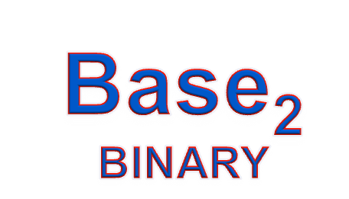


Summary
Successive
Division
  Divide the Decimal Number by 2; the remainder is the LSB of Binary Number .
  If the Quotient Zero, the conversion is complete; else repeat step (a) using the Quotient as the Decimal Number. The new remainder is the next most significant bit of the Binary Number.
Weighted
Multiplication
  Multiply each bit of the Binary Number by it corresponding bit-weighting factor (i.e. Bit-0→2⁰=1; Bit-1→2¹=2; Bit-2→2²=4; etc).
  Sum up all the products in step (a) to get the Decimal Number.
Notes:
Prior to assigning the activity, review the process for DECIMAL-to-BINARY and BINARY-to-DECIMAL.
Binary Number System
Digital Electronics™
2.1 Introduction to AOI Logic
Project Lead The Way, Inc.
Copyright 2009

Slide 56
Bytes
Eight bits form a single byte
  “00110011” is One Byte of Information
Byte Values:
  00000000 = 0
  11111111 = 255
As a result, binary numbers are mostly written as a full byte (00000001)

Slide 57
Special Powers of 2
2¹⁰ (1024) is Kilo, denoted "K"
2²⁰ (1,048,576) is Mega, denoted "M"
2³⁰ (1,073, 741,824)is Giga, denoted "G"
2⁴⁰ (1,099,511,627,776 ) is Tera, denoted “T"

Slide 58
Popular Number Systems
Binary Number System: Radix = 2
  Only two digit values: 0 and 1
  Numbers are represented as 0s and 1s
Octal Number System: Radix = 8
  Eight digit values: 0, 1, 2, …, 7
Decimal Number System: Radix = 10
  Ten digit values: 0, 1, 2, …, 9
Hexadecimal Number Systems: Radix = 16
  Sixteen digit values: 0, 1, 2, …, 9, A, B, …, F
  A = 10, B = 11, …, F = 15
Octal and Hexadecimal numbers can be converted easily to Binary and vice versa

Slide 59
Octal and Hexadecimal Numbers
Octal = Radix 8
Only eight digits: 0 to 7
Digits 8 and 9 not used
Hexadecimal = Radix 16
16 digits: 0 to 9, A to F
A=10, B=11, …, F=15
First 16 decimal values (0 to15) and their values in binary, octal and hex. Memorize table
Decimal Radix 10 | Binary Radix 2 | Octal Radix 8 | Hex Radix 16
0 | 0000 | 0 | 0
1 | 0001 | 1 | 1
2 | 0010 | 2 | 2
3 | 0011 | 3 | 3
4 | 0100 | 4 | 4
5 | 0101 | 5 | 5
6 | 0110 | 6 | 6
7 | 0111 | 7 | 7
8 | 1000 | 10 | 8
9 | 1001 | 11 | 9
10 | 1010 | 12 | A
11 | 1011 | 13 | B
12 | 1100 | 14 | C
13 | 1101 | 15 | D
14 | 1110 | 16 | E
15 | 1111 | 17 | F

Slide 60
Converting Octal & Hex to Decimal
Octal to Decimal: N₈ = (d_{n-1} × 8^{n-1}) +... + (d₁ × 8) + d₀
Hex to Decimal: N₁₆ = (d_{n-1} × 16^{n-1}) +... + (d₁ × 16) + d₀
Examples:
(7204)₈ = (7 × 8³) + (2 × 8²) + (0 × 8) + 4 = 3716
(3BA4)₁₆ = (3 × 16³) + (11 × 16²) + (10 × 16) + 4 = 15268

Slide 61
Converting Decimal to Octal & Hex
Repeatedly divide the decimal integer by 16/8
Each remainder is a hex/octal digit in the translated value
Example: convert 422 to hexadecimal
16
422
remainder
16
26
6
1
A
(1A6)₁₆

Slide 62
Conversion between Bases
In general, conversion between bases can be done via decimal:
Base-2 Base-2
Base-3 Base-3
Base-4 Decimal Base-4
… ….
Base-R Base-R
Shortcuts for conversion between bases 2, 4, 8, 16

Slide 63
Binary, Octal, and Hexadecimal
Binary, Octal, and Hexadecimal are related:
  Radix 16 = 2⁴ and Radix 8 = 2³
Hexadecimal digit = 4 bits and Octal digit = 3 bits
Starting from least-significant bit, group each 4 bits into a hex digit or each 3 bits into an octal digit
Example: Convert 32-bit number into octal and hex
3
5
3
0
5
5
2
3
6
2
4
Octal
1
1
1
0
1
0
1
1
0
0
0
1
0
1
1
0
1
0
1
0
0
1
1
1
1
0
0
1
0
1
0
0
32-bit binary
E
B
1
6
A
7
9
4
Hexadecimal

Slide 64
Binary to Octal
Partition Binary number into group of three digits each
The corresponding octal digit is then assigned to each group
(10110001101011)₂
= (10 110 001 101 011)₂
= (26153)₈

Slide 65
Octal to Binary
Each Octal digit is converted to its three digit binary equivalent
(26153)₈ = (010 110 001 101 011)₂

Slide 66
Hex to Binary
Bin | Hex
0000 | 0
0001 | 1
0010 | 2
0011 | 3
0100 | 4
0101 | 5
0110 | 6
0111 | 7
1000 | 8
1001 | 9
1010 | A
1011 | B
1100 | C
1101 | D
1110 | E
1111 | F
Convention – write 0x before number
Hex to Binary – just convert digits
0x2AC
0010
1010
1100
0x2ac = 001010101100

Slide 67
Binary to Hex
Bin | Hex
0000 | 0
0001 | 1
0010 | 2
0011 | 3
0100 | 4
0101 | 5
0110 | 6
0111 | 7
1000 | 8
1001 | 9
1010 | A
1011 | B
1100 | C
1101 | D
1110 | E
1111 | F
Just convert groups of 4 bits
101001101111011
0101 ⏐
0011 ⏐
0111 ⏐
1011
5
3
7
B
101001101111011 = 0x537B

Slide 68
Important Properties
How many possible digits can we have in Radix r ?
r digits: 0 to r – 1
What is the result of adding 1 to the largest digit in Radix r?
Since digit r is not represented, result is (10)_{r} in Radix r
Examples: 1₂ + 1 = (10)₂ 7₈ + 1 = (10)₈
9₁₀ + 1 = (10)₁₀ F₁₆ + 1 = (10)₁₆
What is the largest value using 3 digits in Radix r?
In binary: (111)₂ = 2³ – 1
In octal: (777)₈ = 8³ – 1
In decimal: (999)₁₀ = 10³ – 1
In Radix r:
largest value = r³ – 1

Slide 69
Important Properties – cont’d
How many possible values can be represented …
Using n binary digits?
Using n octal digits
Using n decimal digits?
Using n hexadecimal digits
Using n digits in Radix r ?
2^{n} values: 0 to 2^{n} – 1
8^{n} values: 0 to 8^{n} – 1
10^{n} values: 0 to 10^{n} – 1
16^{n} values: 0 to 16^{n} – 1
r^{n} values: 0 to r^{n} – 1

Slide 70
References
Chapter 1 – Digital Design Morris Mano
Digital Logic and Computer Design – M. Singh, University of North Carolina
Digital Design – O. Ozturk, Bilknet University
Material in these slides has been taken from, the following resources

